Slide 1
NBA MVP Prediction with Spark + Scala
Lei Liu, Yuchen He Group 4

Slide 2
Facts
There have been 61 MVPs in the NBA with the first being Bob Pettit in the 1956-57 season
Since 1980, the selection of the MVP has been determined by voting from sportswriters and broadcasters
Before that, it was determined by the NBA players
In our project, we use voting share as the target variable to predict.

Slide 3
Dataset
Our dataset is from kaggle https://www.kaggle.com/drgilermo/nba-players-stats.
Voting data is from
https://www.basketball-reference.com/awards/mvp.html
We use player stats from season 2000-2017 as training and testing data, and use season 17-18 stats to make the final prediction.
2000-2017 data has over 100,000 records

Slide 4
Random Forest and Evaluation Method
We created random forest model to make predictions and get RMSE(Root Mean Square Error) to evaluate our model.
Then we compare the MVP predictions with actual results in 17-18 season
Acceptance Criteria
Get 80% accuracy in Top 10 MVP candidates.
Target RMSE of final MVP prediction is lower than 0.05.

Slide 5
Learning Strategy
Import and prepare data
Optimize the model by setting thresholds
Vectorize features
Create Random Forest Model
Train the model and test
Make MVP predictions for 17-18 season

Slide 6
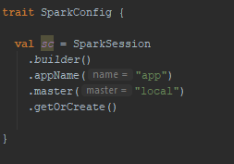
Methods
SparkConfig

Slide 7
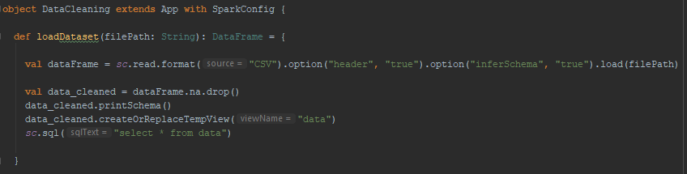
Methods
DataCleaning--Load Dataset

Slide 8
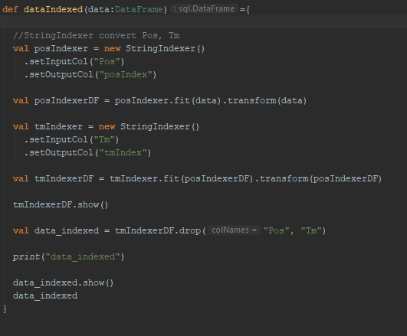
Methods
DataCleaning--StringIndexer

Slide 9
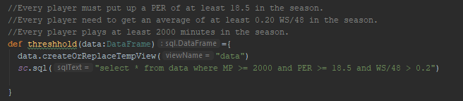
Methods
DataCleaning--Threshold

Slide 10
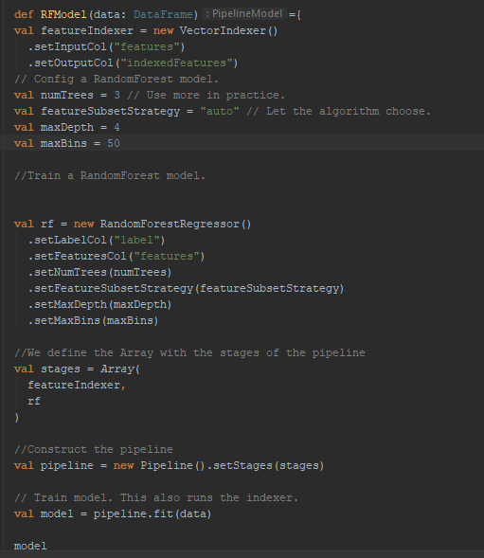
Methods
Pipeline Model

Slide 11
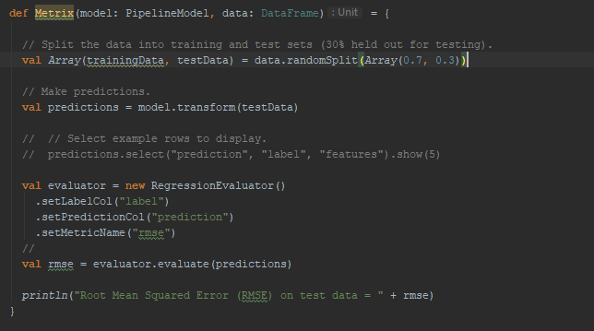
Methods
Metric--rmse

Slide 12
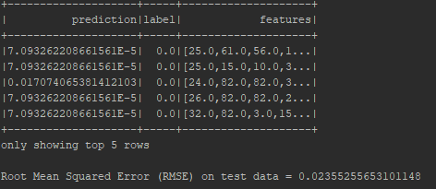
Results
Rmse: 0.0236
Acceptance Criteria: 0.05

Slide 13
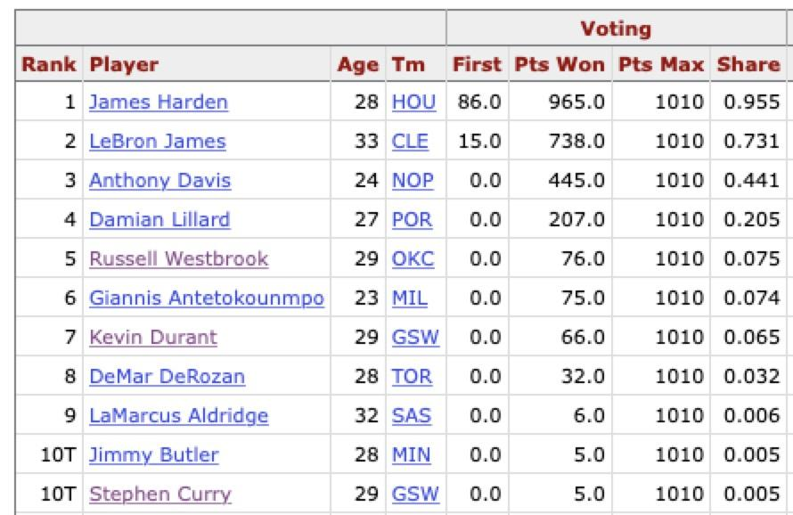
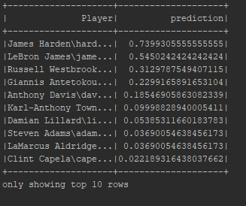
Results
Top2 Correct
70% accuracy in Top10
Acceptance Criteria: 80%

Slide 14
Q & A?

